Slide 1






Collaborative Large Language Model (LLM) for Recommender Systems
Yaochen Zhu¹², Liang Wu², Qi Guo², Liangjie Hong¹, Jundong Li¹²
¹University of Virginia, ²LinkedIn Inc.
Accepted as a conference paper for WWW 2024
work done when Yaochen was an applied research intern at LinkedIn
Notes:
Thanks for comining

Slide 2








Background
Recommender System Overview
Purpose: Suggest new items to users based on personalized interests
items
users
Will user 4 watch movie 4?
Collaborative Large Language Model (LLM) for Recommender Systems
Notes:
So this is a recommender systems session and this is also the webconf, I don’ think I need to emphasize the importance of recommender systems

Slide 3
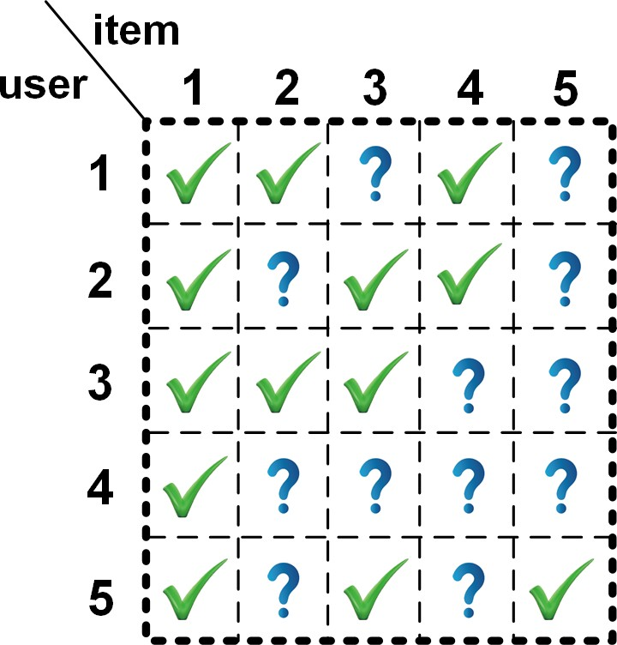
Background
Recommender System Overview
Purpose: Suggest new items to users based on personalized interests
items
Predict the missing values in:
users
Will user 4 watch movie 4?
user-item interaction matrix
Collaborative Large Language Model (LLM) for Recommender Systems

Slide 4

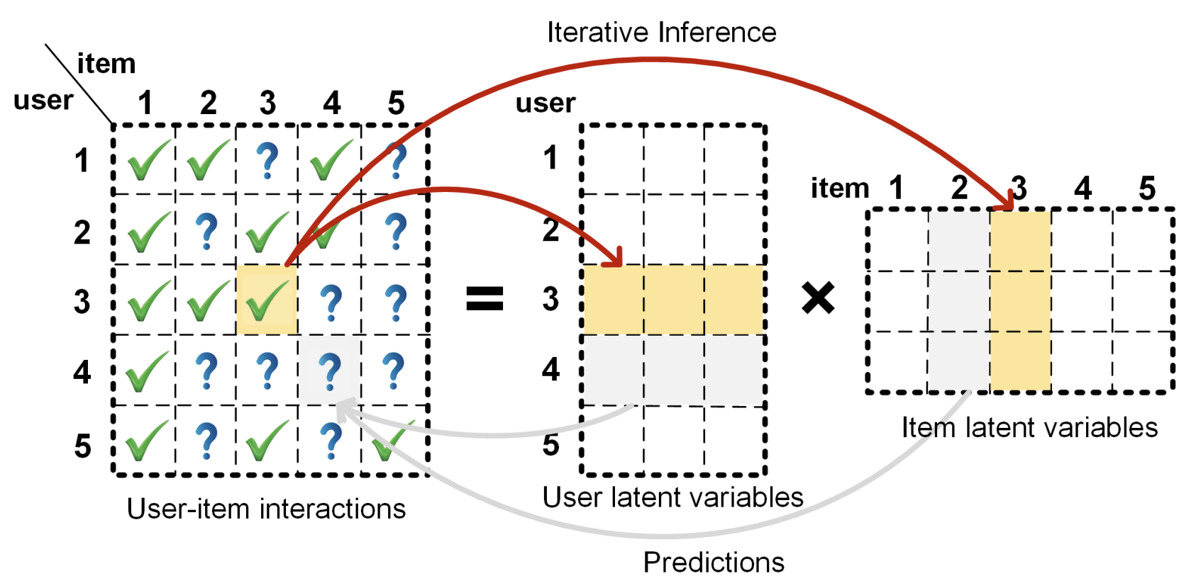
Background
ID-based Recommender System
Matrix factorization
Starts with the Netflix Prize in 2006!
Collaborative Large Language Model (LLM) for Recommender Systems
Notes:
RS has long been dominated by the ID-based paradigm,

Slide 5
Background
ID-based Recommender System
Matrix factorization
Two tower model
Matching Score
dot product
Neural Network
Neural Network
Member Embeddings
Job Embeddings
Starts with the Netflix Prize in 2006!
LinkedIn job recommendation!
Collaborative Large Language Model (LLM) for Recommender Systems

Slide 6
Background
ID-based Recommender System
Matrix factorization
Two tower model
Matching Score
dot product
Neural Network
Neural Network
Member Embeddings
Job Embeddings
Starts with the Netflix Prize in 2006!
LinkedIn job recommendation!
Commonality: Representing each user/item with a unique, continuous ID embedding
Collaborative Large Language Model (LLM) for Recommender Systems
Notes:
Represent each user/item with a unique, continuous ID embeddings

Slide 7
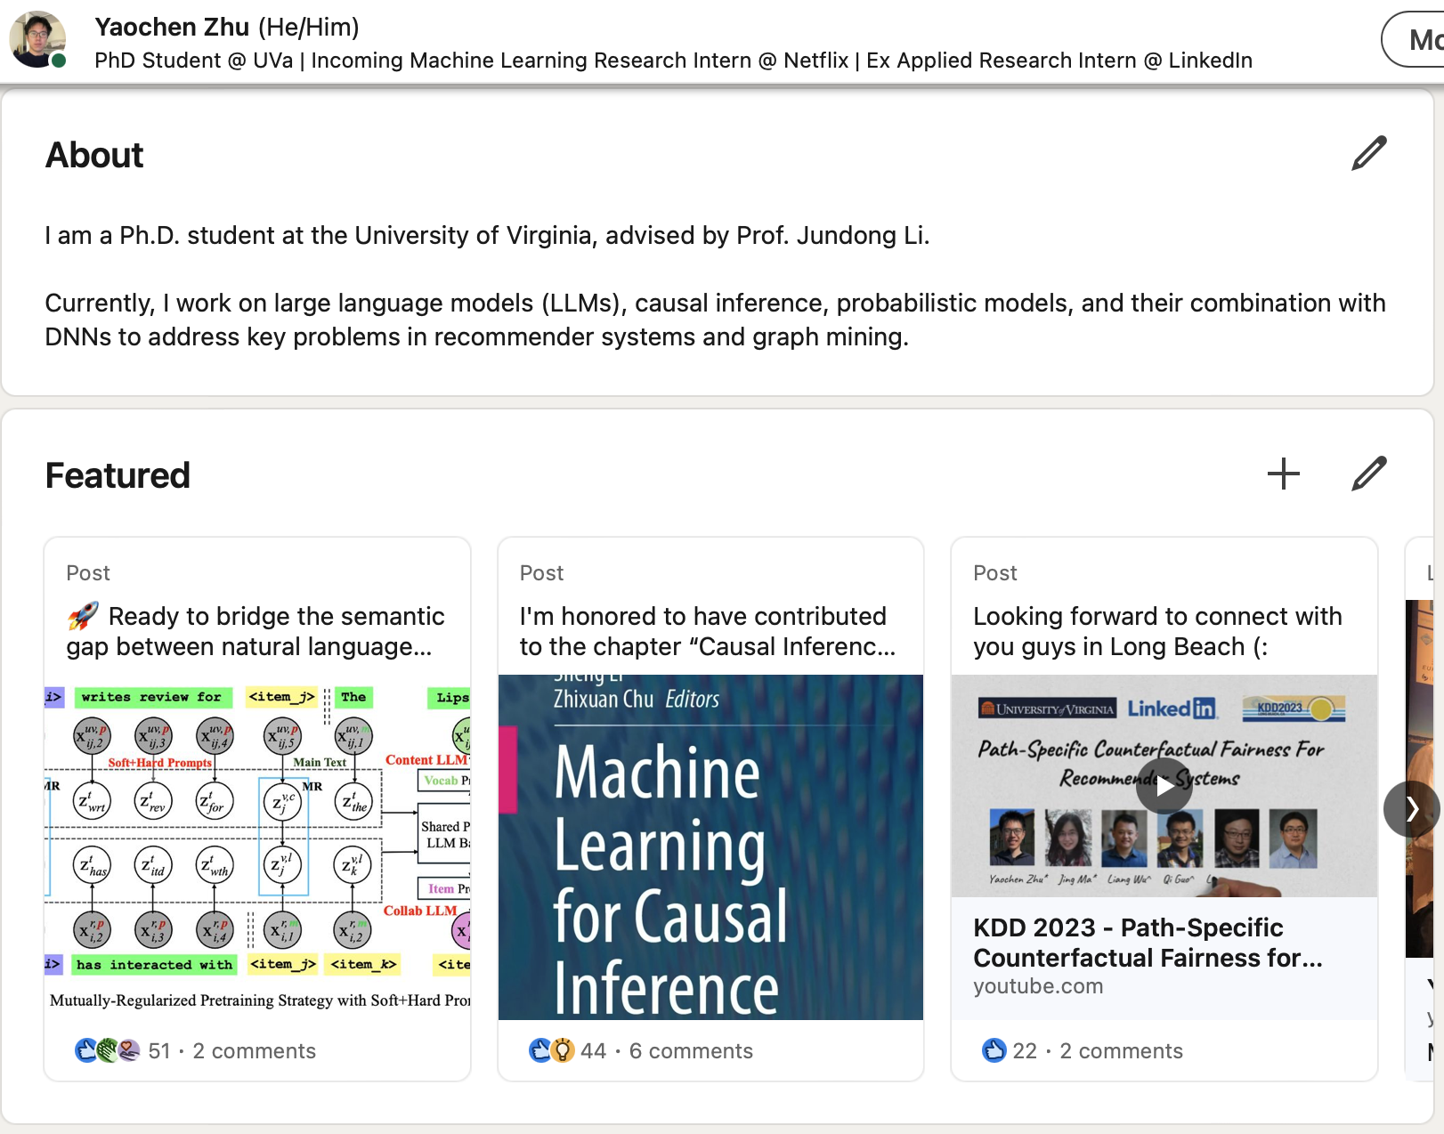
Background
Problem of ID-based Recommender System
User side textual features
e.g., biography, demographical features
Collaborative Large Language Model (LLM) for Recommender Systems

Slide 8
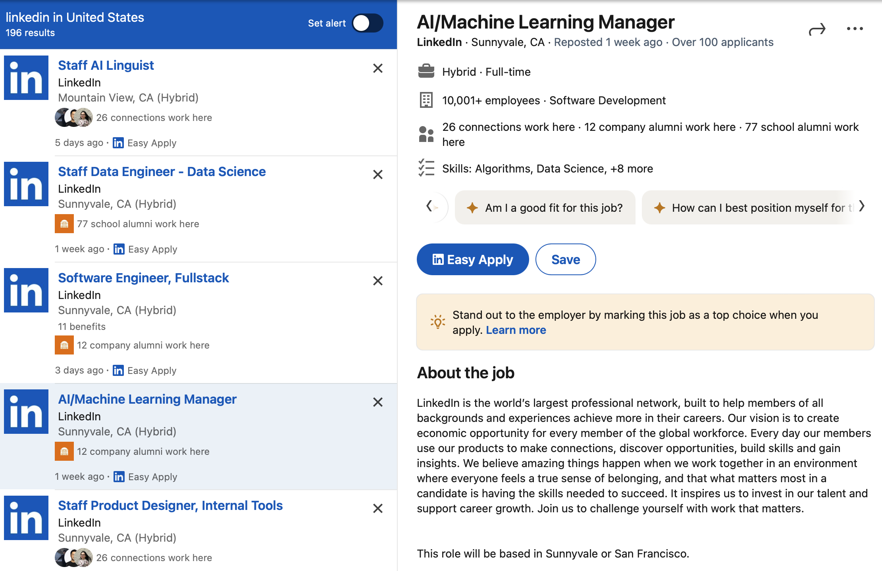
Background
Problem of ID-based Recommender System
User side textual features
Item side textual features
e.g., biography, demographical features
e.g., content, descriptions
Collaborative Large Language Model (LLM) for Recommender Systems

Slide 9
Background
Problem of ID-based Recommender System
User side textual features
Item side textual features
e.g., biography, demographical features
e.g., content, descriptions
Challenge: Difficult for ID embeddings to understand the rich textual information
Collaborative Large Language Model (LLM) for Recommender Systems

Slide 10
Motivation
The Advent of Large Language Model (LLM)
revolutionizes how we can…
Collaborative Large Language Model (LLM) for Recommender Systems
Notes:
large language models (LLM) have become a heated topic for both academia and industry
By pretrained on large-scale corpora, have demonstrated emergent ability and show unprecedented understandings of knowledge and patterns in natural language

Slide 11
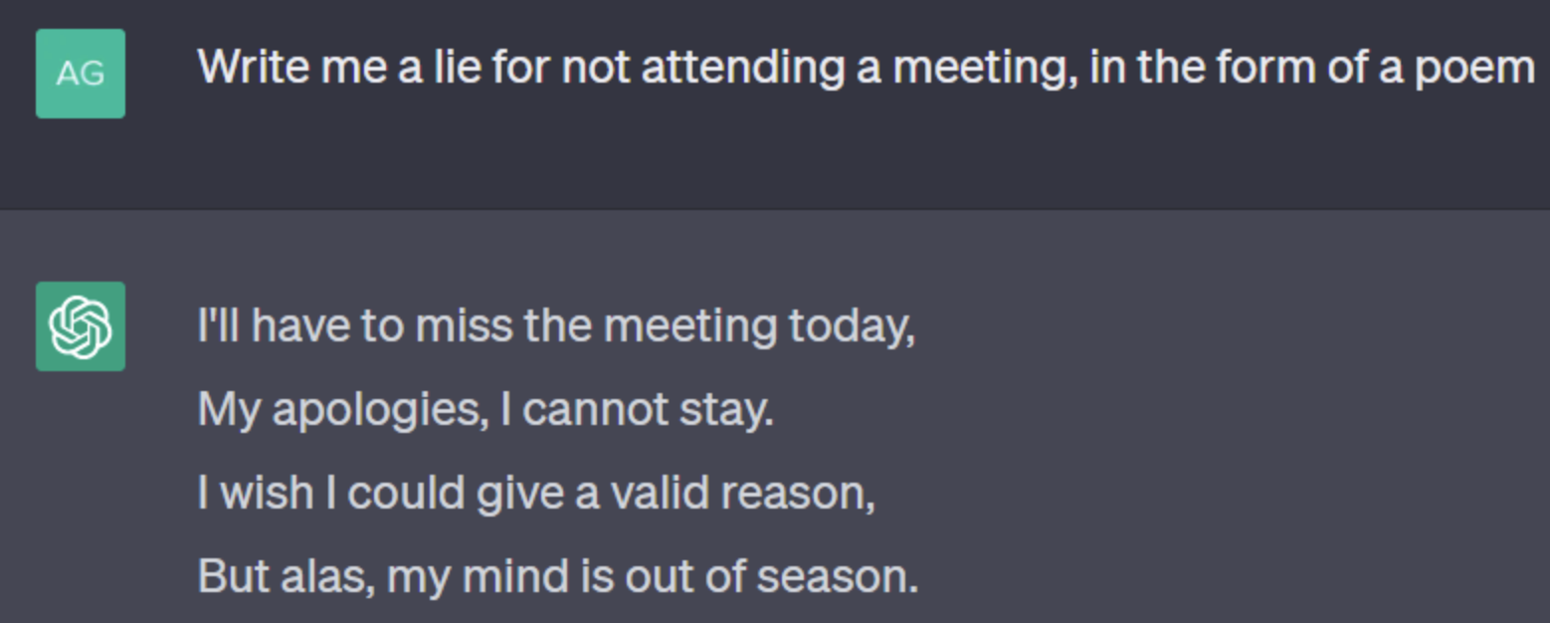
Motivation
The Advent of Large Language Model (LLM)
revolutionizes how we can…
write things proficiently
Collaborative Large Language Model (LLM) for Recommender Systems

Slide 12
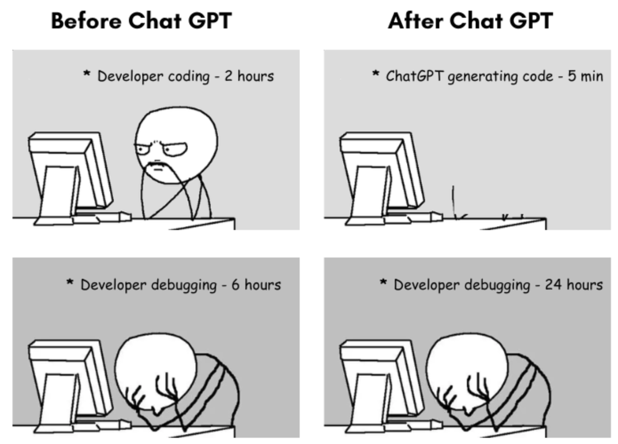
Motivation
The Advent of Large Language Model (LLM)
revolutionizes how we can…
write things proficiently
write codes efficiently
Collaborative Large Language Model (LLM) for Recommender Systems

Slide 13
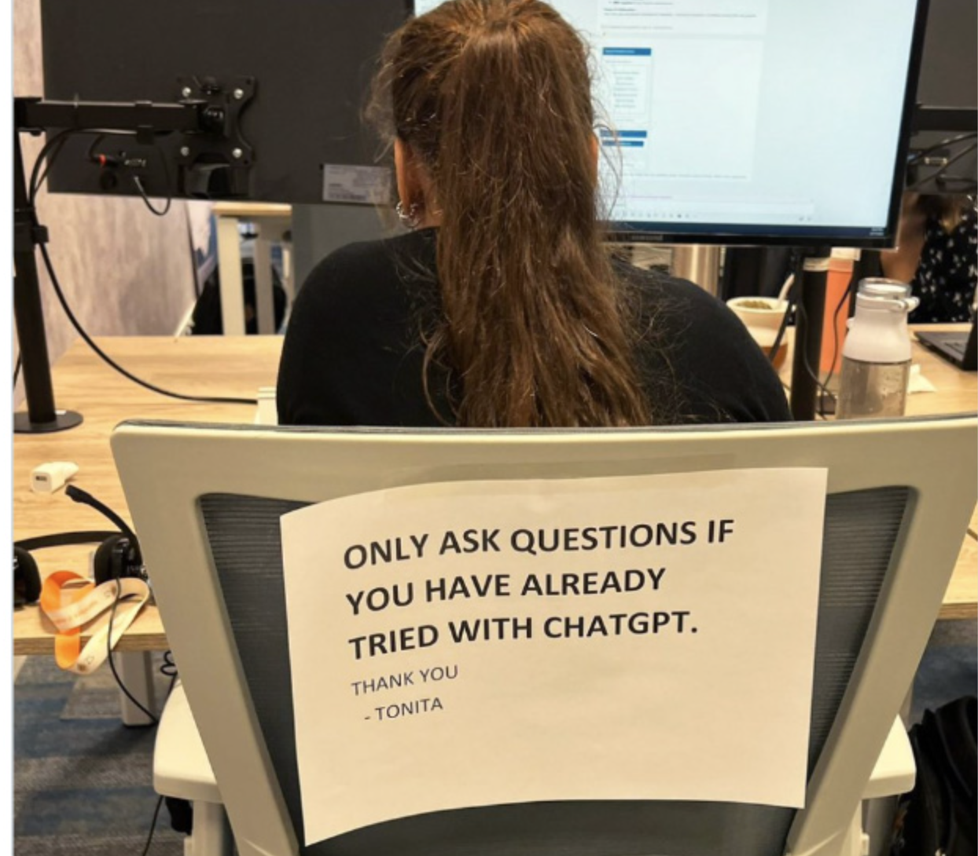
Motivation
The Advent of Large Language Model (LLM)
revolutionizes how we can…
write things proficiently
get information promptly
write codes efficiently
Collaborative Large Language Model (LLM) for Recommender Systems

Slide 14
Motivation
The Advent of Large Language Model (LLM)
revolutionizes how we can…
write things proficiently
get information promptly
write codes efficiently
Therefore, it is natural to think how recommender systems can benefit from LLMs
Collaborative Large Language Model (LLM) for Recommender Systems
Notes:
it is promising to develop the next generation of RS based on pretrained LLMs [14], fully utilizing their encoded knowledge, logical reasoning ability, and generative AI power to understand and reason with user/item semantics and make more accurate recommendations accordingly,

Slide 15
Main Challenges
Inherent Gap Between Language and Recommendations
Collaborative Large Language Model (LLM) for Recommender Systems

Slide 16

Main Challenges
Inherent Gap Between Language and Recommendations
User/Item Representation
“item”
tokenize
“_”
“95”
“item_9527”
“27”
Collaborative Large Language Model (LLM) for Recommender Systems
Notes:
One main challenge is the gap between natural language and user/item semantics

Slide 17

Main Challenges
Inherent Gap Between Language and Recommendations
User/Item Representation
“item”
tokenize
“_”
“95”
“item_9527”
“27”
Three tokens overlap with “item_95”
Unfaithful user/item representation
Collaborative Large Language Model (LLM) for Recommender Systems
Notes:
the ID word may be broken down into atomic tokens, where spurious correlations can be introduced for irrelevant users/items

Slide 18
Main Challenges
Inherent Gap Between Language and Recommendations
User/Item Representation
Inefficient Recommendation
“item”
“item”
tokenize
“_”
“_”
Auto-regression
“95”
“item_9527”
“item_9527”
“95”
“27”
“27”
Three tokens overlap with “item_95”
Unfaithful user/item representation
Collaborative Large Language Model (LLM) for Recommender Systems

Slide 19
Main Challenges
Inherent Gap Between Language and Recommendations
User/Item Representation
Inefficient Recommendation
“item”
“item”
tokenize
“_”
“_”
Auto-regression
“95”
“item_9527”
“item_9527”
“95”
“27”
“27”
Three tokens overlap with “item_95”
Needs 4 steps to recommend 1 item
Unfaithful user/item representation
Inefficient recommendation
Collaborative Large Language Model (LLM) for Recommender Systems

Slide 20
Methodology: CLLM4Rec
Contributions Overview
Novel ID + LLM Paradigm
Faithful representation of users and items in LLMs
New Pretrain Strategy
Effective learning of user/item token embeddings
New Finetuning Strategy
Efficient recommendation without hallucination
Collaborative Large Language Model (LLM) for Recommender Systems
Notes:
the first generative RS that tightly couples the ID paradigm and LLM paradigm,
where user/item ID token embeddings aligned to the LLM vocab space are introduced to well capture the intrinsic user interests and item properties
3. where recommendations of multiple items can be generated efficiently without hallucination

Slide 21
Methodology: CLLM4Rec
New Paradigm that Combines ID and LLM
We introduce user/item IDs as new tokens with corresponding token embeddings
<a>
<an>
<zulu>
vocab embeddings
Collaborative Large Language Model (LLM) for Recommender Systems

Slide 22
Methodology: CLLM4Rec
New Paradigm that Combines ID and LLM
We introduce user/item IDs as new tokens with corresponding token embeddings
<a>
<user_1>
<item_1>
<an>
<user_2>
<item_2>
extend
<zulu>
<user_I>
<item_J>
vocab embeddings
User ID embeddings
Item ID embeddings
Collaborative Large Language Model (LLM) for Recommender Systems

Slide 23
Methodology: CLLM4Rec
New Paradigm that Combines ID and LLM
We introduce user/item IDs as new tokens with corresponding token embeddings
<a>
<user_1>
<item_1>
<an>
<user_2>
<item_2>
extend
<zulu>
<user_I>
<item_J>
vocab embeddings
User ID embeddings
Item ID embeddings
Benefits: User/item semantics can be faithfully represented
Collaborative Large Language Model (LLM) for Recommender Systems
Notes:
We first extend the vocabulary of pretrained LLMs with user/item ID tokens to faithfully model user/item collaborative and content semantics.

Slide 24
Methodology: CLLM4Rec
Question 1
How to effectively learn the user/item ID token embeddings?
Collaborative Large Language Model (LLM) for Recommender Systems

Slide 25
Methodology: CLLM4Rec
Pretraining: Soft+Hard Prompting
Collaborative Large Language Model (LLM) for Recommender Systems

Slide 26
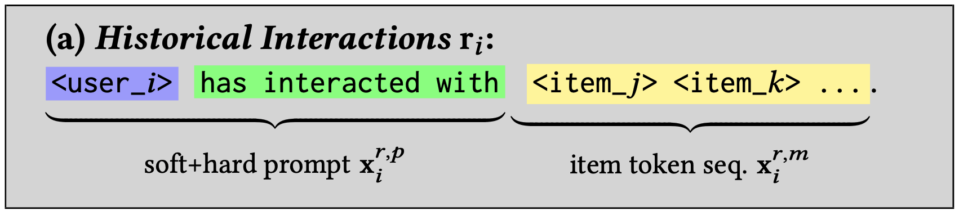
Methodology: CLLM4Rec
Pretraining: Soft+Hard Prompting
Collaborative Corpora
transform
Natural language
Interactions
Collaborative Large Language Model (LLM) for Recommender Systems
Notes:
a novel soft+hard prompting strategy is proposed to effectively learn user/item collaborative/content token embeddings via language modeling on RS-specific corpora

Slide 27
Methodology: CLLM4Rec
Pretraining: Soft+Hard Prompting
Collaborative Corpora
transform
Natural language
Interactions
We can observe that the collaborative document can be split into:
The context part with heterogenous user/vocab tokens
The completion part with homogenous item tokens
Collaborative Large Language Model (LLM) for Recommender Systems

Slide 28
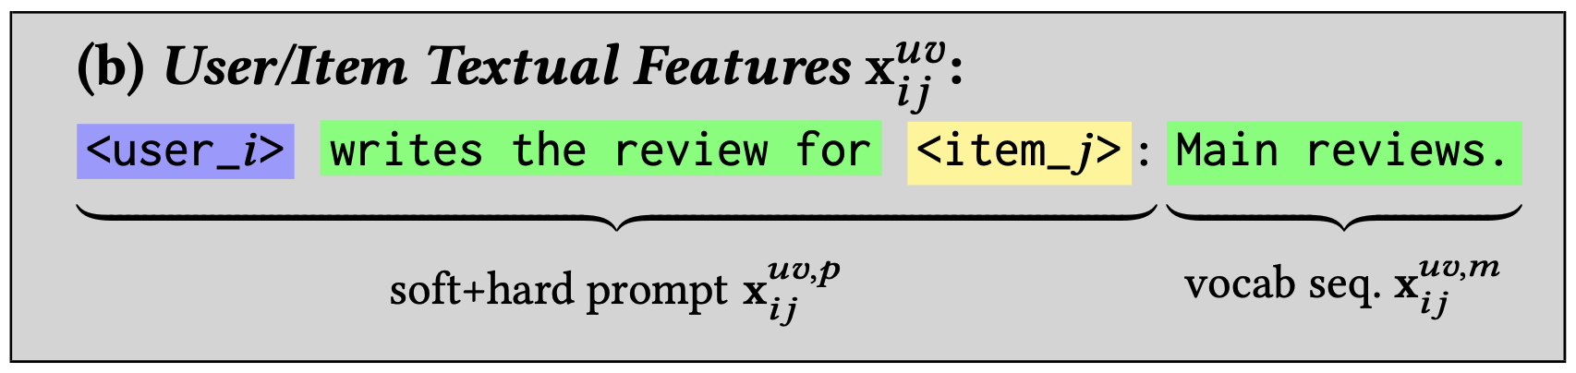
Methodology: CLLM4Rec
Pretraining: Soft+Hard Prompting
Content Corpora
transform
Collaborative Large Language Model (LLM) for Recommender Systems

Slide 29
Methodology: CLLM4Rec
Pretraining: Soft+Hard Prompting
Content Corpora
transform
We can observe that the content document can be split into:
The context part with heterogenous user/item/vocab tokens
The completion part with homogenous vocab tokens
Collaborative Large Language Model (LLM) for Recommender Systems

Slide 30
Methodology: CLLM4Rec
Pretraining: Soft+Hard Prompting
Content Corpora
transform
Strategy
We view the heterogenous context as a soft+hard prompt
Language modeling is conducted on the homogenous completion part
Collaborative Large Language Model (LLM) for Recommender Systems

Slide 31
Methodology: CLLM4Rec
Pretraining: Soft+Hard Prompting
Content Corpora
transform
Strategy
We view the heterogenous context as a soft+hard prompt
Language modeling is conducted on the homogenous completion part
Benefits: The learning of user/item ID token embeddings can be stable and effective
Collaborative Large Language Model (LLM) for Recommender Systems
Notes:
conducting language modeling (LM) on sequences with heterogeneous tokens can be ineffective and unstable, especially when the vocabulary of most LLMs can be diluted (e.g., ∼ 50k for GPT, and ∼ 30k for T5) by a large number of randomly initialized user/item embeddings.

Slide 32
Methodology: CLLM4Rec
Question 2
How to use the LLM and learned user/item embeddings for recommendation?
Collaborative Large Language Model (LLM) for Recommender Systems

Slide 33
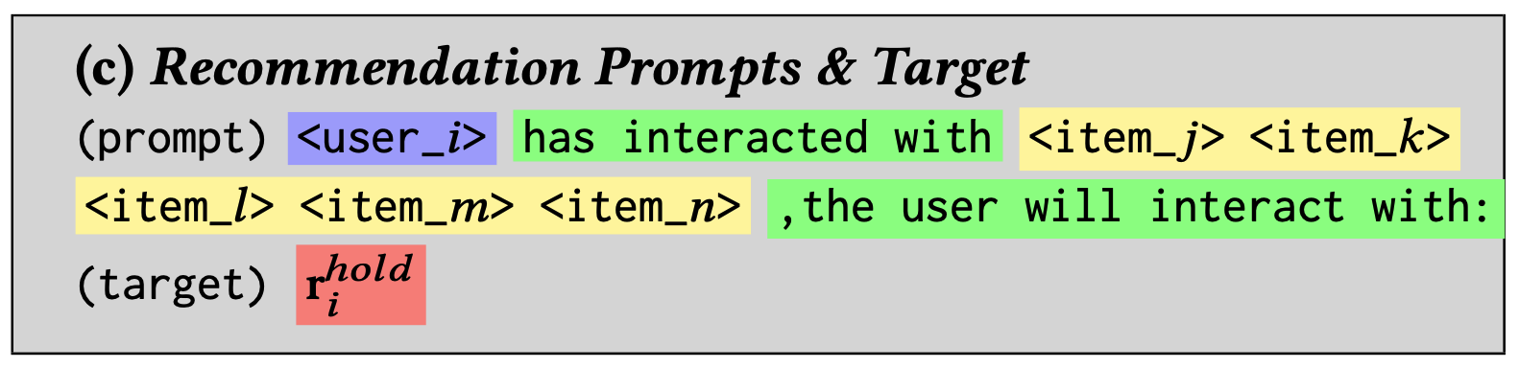
Methodology: CLLM4Rec
Recommendation-Oriented Finetuning
Collaborative Corpora
Collaborative Large Language Model (LLM) for Recommender Systems

Slide 34
Methodology: CLLM4Rec
Recommendation-Oriented Finetuning
Collaborative Corpora
randomly mask out items in the prompt
Collaborative Large Language Model (LLM) for Recommender Systems

Slide 35
Methodology: CLLM4Rec
Recommendation-Oriented Finetuning
Collaborative Corpora
Pretrained LLM with pretrained user/item token embeddings
dense embedding of the prompt
Benefits: Efficient recommendation of multiple items with no hallucination
Collaborative Large Language Model (LLM) for Recommender Systems
Notes:
propose a stochastic item reordering strategy to randomly permute the item tokens

Slide 36
Methodology: CLLM4Rec
Recommendation-Oriented Finetuning
Collaborative Corpora
0
1
item_k
predict
Pretrained LLM with pretrained user/item token embeddings
1
item_m
0
dense embedding of the prompt
A multi-hot vector
Benefits: Efficient recommendation of multiple items with no hallucation
Collaborative Large Language Model (LLM) for Recommender Systems

Slide 37
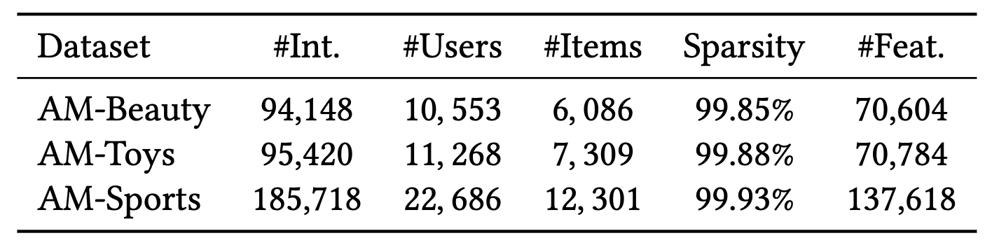
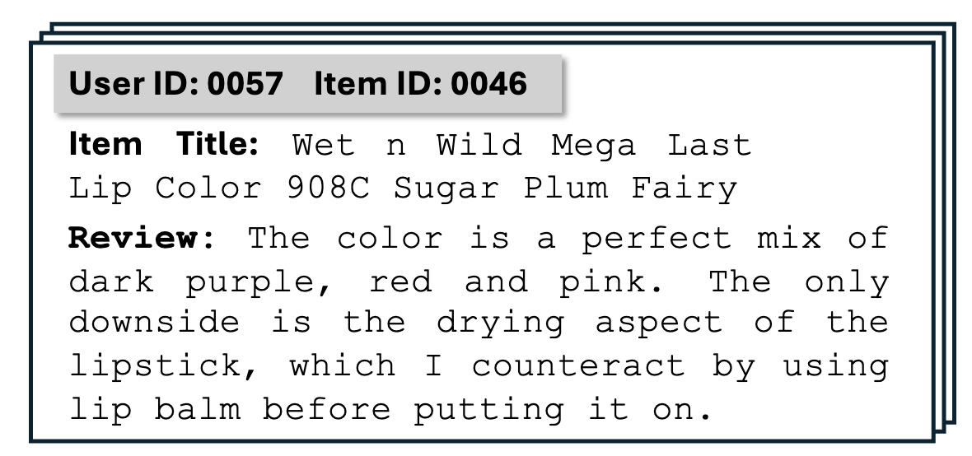
Experimental Results
Amazon datasets
Dataset statistics
Exemplar textual features
Collaborative Large Language Model (LLM) for Recommender Systems

Slide 38
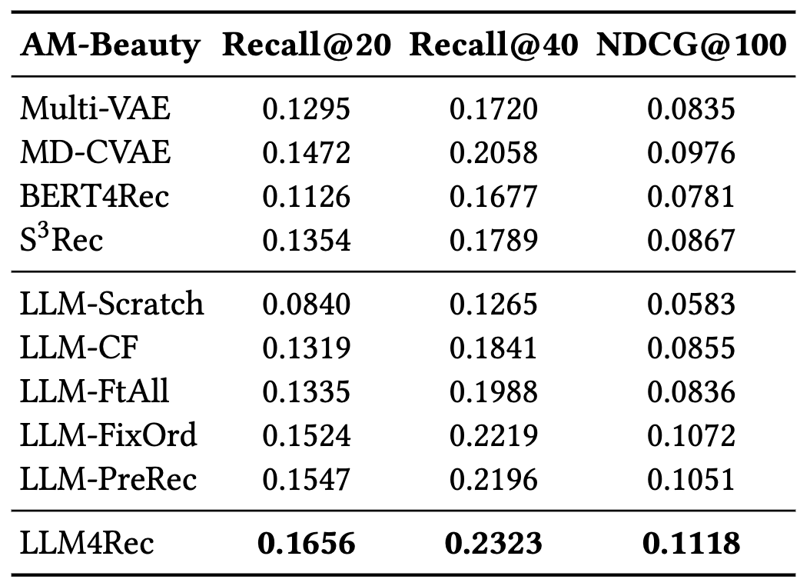
Experimental Results
Amazon datasets
Dataset statistics
Experimental results
ID-based Baselines
Exemplar textual features
LLM-based Baselines
Collaborative Large Language Model (LLM) for Recommender Systems

Slide 39
Experimental Results
Amazon datasets
Dataset statistics
Experimental results
ID-based Baselines
Exemplar textual features
LLM-based Baselines
Results: The proposed LLM4Rec out-performs both ID-based and LLM-based baselines
Collaborative Large Language Model (LLM) for Recommender Systems
Notes:
they represent users/items with multiple tokens and formulate direct recommendation as a next token generation problem. Since the generated tokens could be irrelevant to the recommendation purpose, candidate items usually need to be explicitly provided in the prompt to avoid hallucination

Slide 40
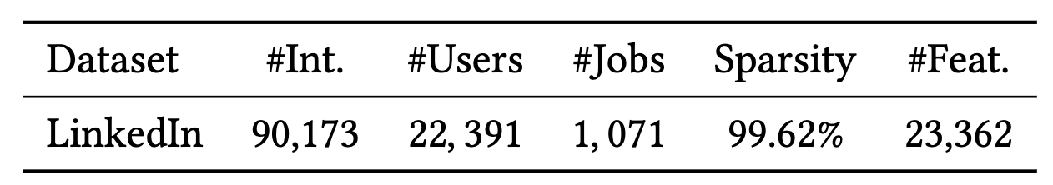
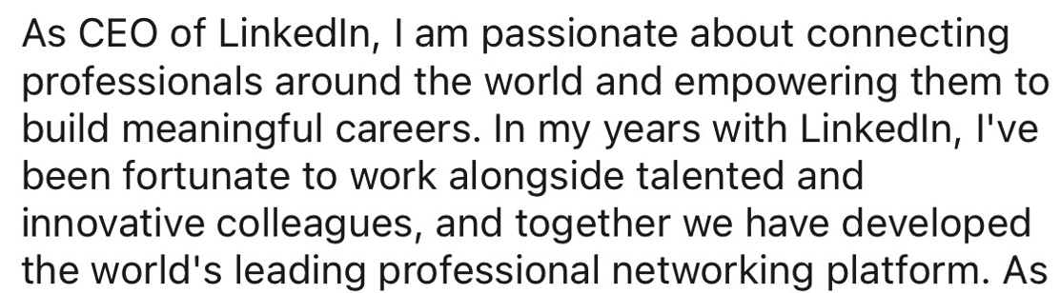
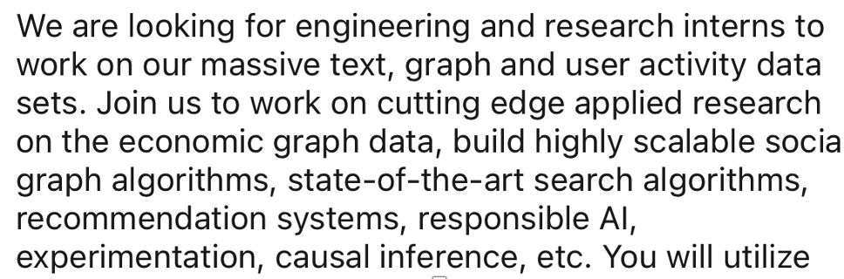
Experimental Results
LinkedIn Datasets
Dataset statistics
Exemplar textual features
user features
job features
Collaborative Large Language Model (LLM) for Recommender Systems

Slide 41
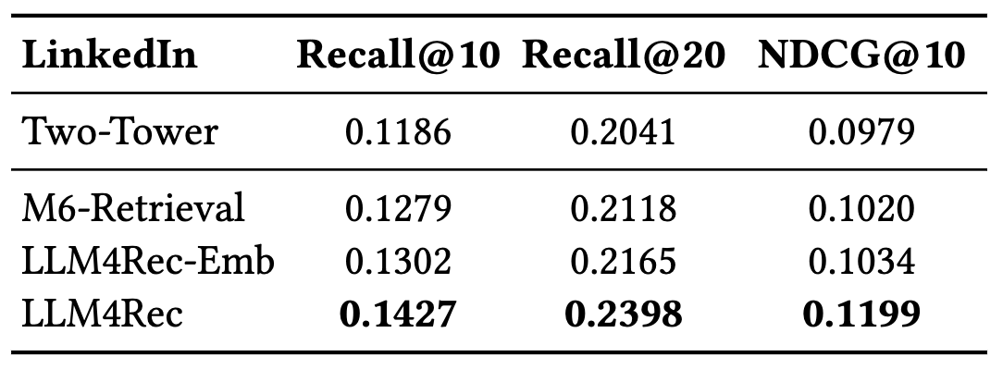
Experimental Results
LinkedIn Datasets
Dataset statistics
Experimental results
Exemplar textual features
user features
Baselines
job features
Two-Tower: Existing ID-based RS used in LinkedIn
M6-Retrival: Use LLM to encode user/item features for matching
LLM4Rec-Emb: Use embeddings learned by LLM4Rec for matching
Collaborative Large Language Model (LLM) for Recommender Systems

Slide 42
Experimental Results
LinkedIn Datasets
Dataset statistics
Experimental results
Exemplar textual features
user features
Baselines
job features
Two-Tower: Existing ID-based RS used in LinkedIn
M6-Retrival: Use LLM to encode user/item features for matching
LLM4Rec-Emb: Use embeddings learned by LLM4Rec for matching
Results: The proposed LLM4Rec out-performs various baselines in the real-world setting
Collaborative Large Language Model (LLM) for Recommender Systems

Slide 43
Thank you so much for listening!
Collaborative Large Language Model (LLM) for Recommender Systems

